Slide 1
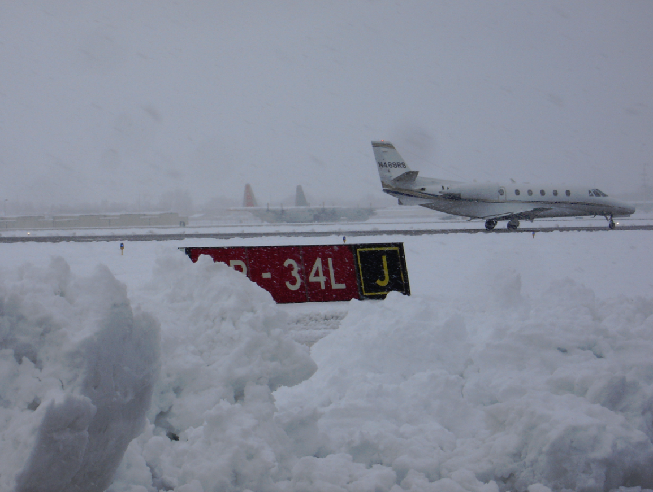
TAFs -
Strengths, Limitations
Dawn Johnson - NWS Reno, NV
Lead Forecaster
Aviation Program Manager
Dawn.Johnson@noaa.gov
IWAWS 2018
...and other ways to get weather information

Slide 2
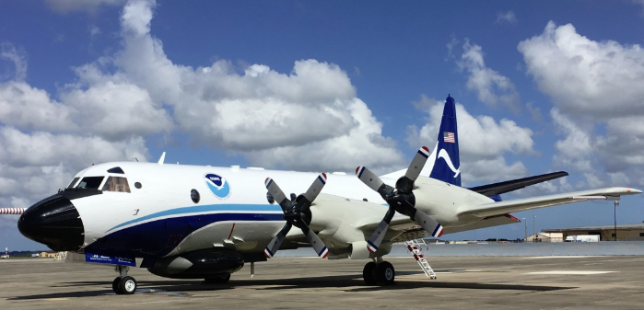
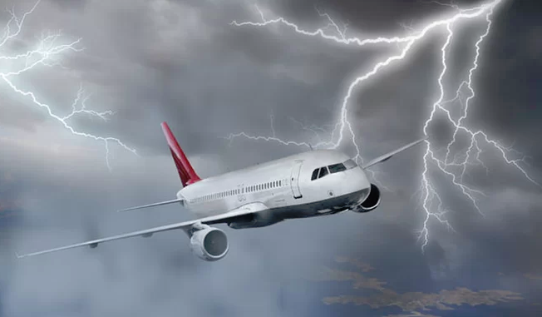
How Familiar are you with the TAF?
What is a TAF?
Are the cloud values in MSL or AGL?
When are TAFs updated?
How long are they valid for?
What information can a TAF tell you?
What area does a TAF cover?
Do thunderstorms in the forecast imply wind shear?
Can a TAF for one airport be used for another site 20 miles away?

Slide 4
What is a TAF?
Forecaster Discussion
VC
5-10 mi
0-5 mi
KXYZ
Forecaster Discussion
Notes:
A TAF is a decision making tool prepared by NWS forecast offices. They are issued routinely every 6 hours (though core 30 airports have 3 hourly mandatory issuances) at 00, 06, 12, and 18z and will apply to a 24-30 hour forecast period.

Slide 5
How the heck do I read this thing?!?
KXYZ 171721Z 1718/1818 18016KT P6SM VCTS FEW009 BKN050CB BKN250
TEMPO 1719/1722 VRB15G25KT 2SM +TSRA BLDU SCT015CB OVC050
FM172200 23010KT 6SM -SHRA SCT015 BKN040
FM180300 32006KT P6SM VCSH SCT050 BKN120
FM180800 35010G20KT P6SM FEW070 SCT150 WS020/20045KT
Notes:
What does a TEMPO group mean?

Slide 6
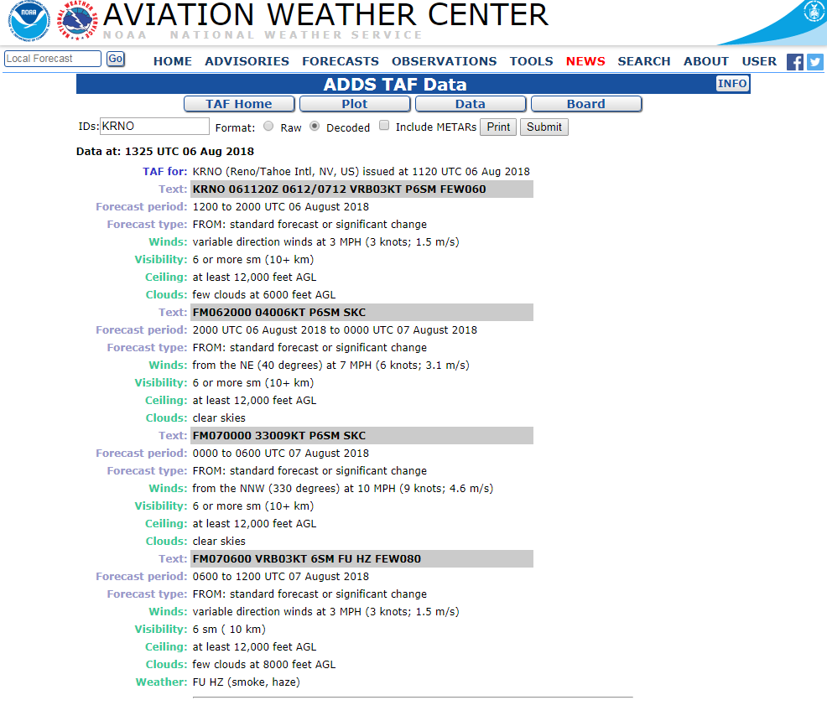
Did you Know...

Slide 7
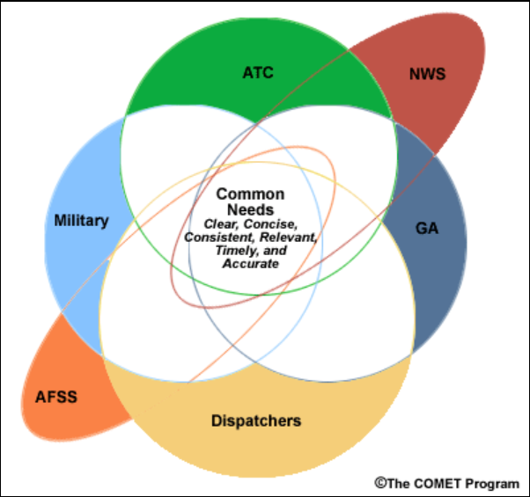
The problem with the TAF
There are a lot of different users of the TAF
You can’t make everyone happy at the same time
How is it used?
It’s being asked to do more than can be done in a few lines

Slide 8
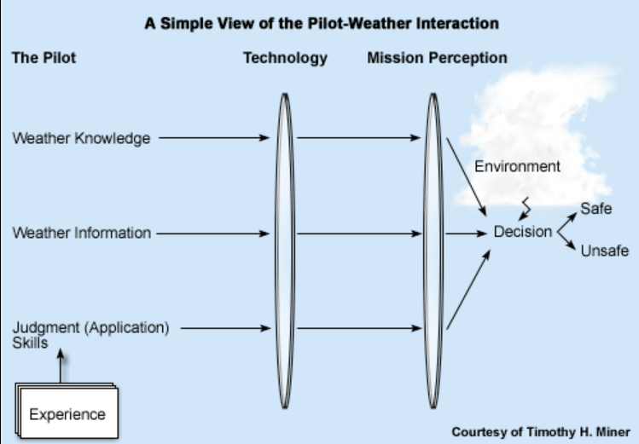
Notes:
Most GA pilots have basic weather training with their knowledge coming primarily from experience and what they learn during preflight briefings. The usefulness of the weather information is related to both the pilot’s knowledge and experience to the clarity of the information. If pilots are receiving a briefing, the person can only relay the clarity of what they are given in a forecast. If a pilot is doing a self-brief, confusing TAFs may send mixed messages or lack of confidence. How a pilot applies this weather information and makes a judgement will depend largely on experience. Does technology make you safer or give you a false sense of security? How important does the pilot feel the mission of the flight is? Will more risk be taken for an important flight?

Slide 9
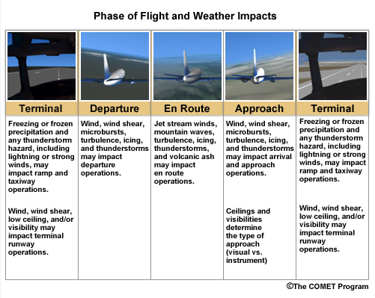
Notes:
What part of your flight can you not use a TAF for? Your TAF is good at the Terminal site and can be used for near-range departure and approach forecasts, but can’t be used for planning en route. You want to rely on the upper air forecasts and weather information from your flight briefing at that point.

Slide 10
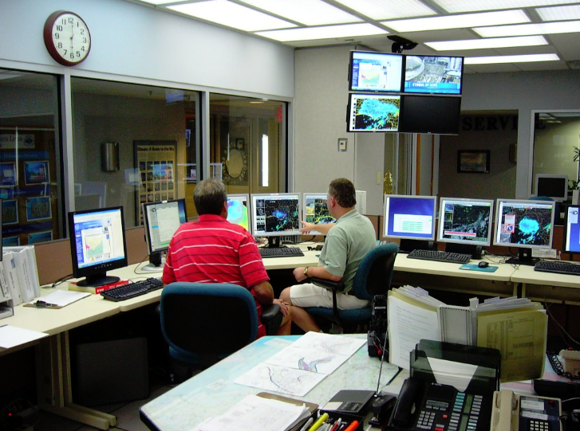
Strengths of a TAF
Concise
Similar coding to a METAR
Local forecaster knowledge
Commonly used tool
Great for a general planning forecast
Direct forecaster involvement

Slide 11
Limitations of the TAF
Cannot put in confidence details
Trends can be portrayed, but timing may be off
No way to convey frozen precip accumulation
Thunderstorm details
Very localized
Forecasters are limited by the length of the TAF
Can’t include any density altitude info
Direct forecaster involvement - unintended human filters

Slide 12
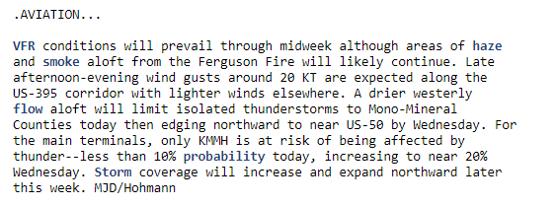
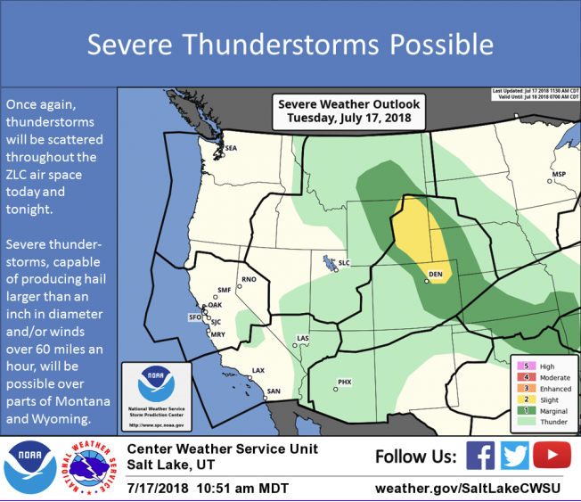
What else should I be looking at?
Social Media
Graphics and NWS homepages (includes CWSU and AWC)
Official Flight Briefings
Software and apps for your tablet

